Slide 1
EduLoyalty Reward Point System
</
/>
Presenting = (“ Parisha Desai ”,
“ Prasad Mahabare ”,
“ Shruthi Mandaokar ”,
“ Suparshwa Patil ”)

Slide 2

</Project Overview
Objective :
Encourage Active Participation
Improve Student Engagement
End Users:
Students(Prospective and Returning)
Faculty
Admin Staff
Purpose:
Front End and Back End Integration
Implement ETL
Notes:
Firstly – what the project is –
Reward point loyalty system – capture user activity on website like that of Purdue and assign rewards in form of coupons by tracking user activity wherein we are giving points each time user logs in or accesses website. Various pts and badges are assigned depending on user activity
Objective
– increase user engagement with website by giving them various perks or rewards ; so they use it more often and get more familiar with it
Our end users
- Prospective and continuing students accessing website for admission or course enrollment purposes
- Faculty or admin staff accessing website for verifying different information
Purpose of taking this project
- we will get to learn working on project involving frontend and backend integration using of API & DB
- able to Implement extract transform Load not just at DB level but also over webservices/API that shall be used
Vision- to track user activity on purdue domain – pfw or purdue .edu website but accessing code challenge hence dummy website

Slide 3
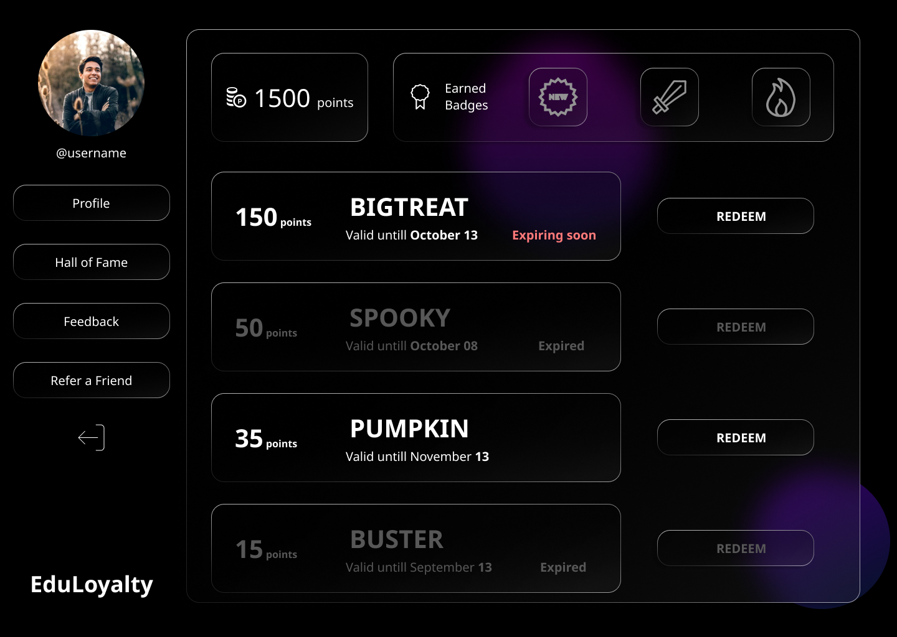
</Requirements
Functional
Sign Up & Login
Dashboard
Points
Coupons
Hall of Fame
Refer a friend
Non-Functional
Security
Interpretability
Maintainability
Notes:
Functionality
Sign Up & Login –User will signup using username password and during login has to use same creds
Dashboard- after login user navigated to Landing page – Main page were all details related to Points collected; Coupons assigned and badges earned. Points assigned for logins each time, for referring for submitting feedback. Coupons have a validity date and then expire if not used if redeemed or expired grayed out
Hall of Fame- Top scorers displayed basis points
Refer a friend- Points earned when another user signs up using referral code of existing user
Feedback – can submit feedback to improve website
Security – we shall be using bearer token to authenticate user request; to ensure legitimate request are only accepted
Interpretability- website will be responsive and easily accessible across all mobile devices
Maintainability- user & app logs will be maintained

Slide 4
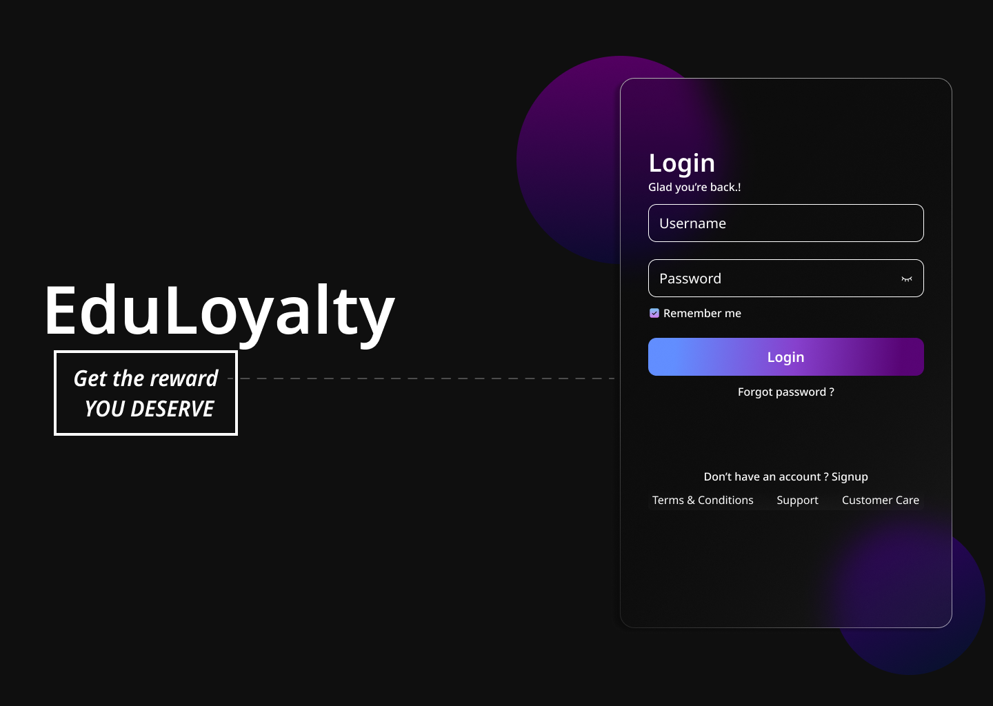

</Requirements
Nice to have
Extension
Purdue Domain
Notes:
Dummy website explain – were we are tracking
Extension – can be created in future
We can extend the dummy website functionality to a actual website like a Purdue website if we have access to their code

Slide 5



</System Architecture
User Interface (React)
Middleware (REST API)
Back End
DB
(MySQL)
Web
Services
Python
Django Framework
Notes:
Client Server architecture
3 main components
UI-Frontend will be React – responsive
Middleware – REST API for exchanging information
Backend – Webservices – Microservice architecture
- that will process information , compute points, assign coupons and badges that will be displayed at frontend thus transform data and ensure it is stored in database
- Python and Django framework
We will ensure that Code runs fine on ubuntu – Linux and Windows server
We will maintain logs

Slide 6
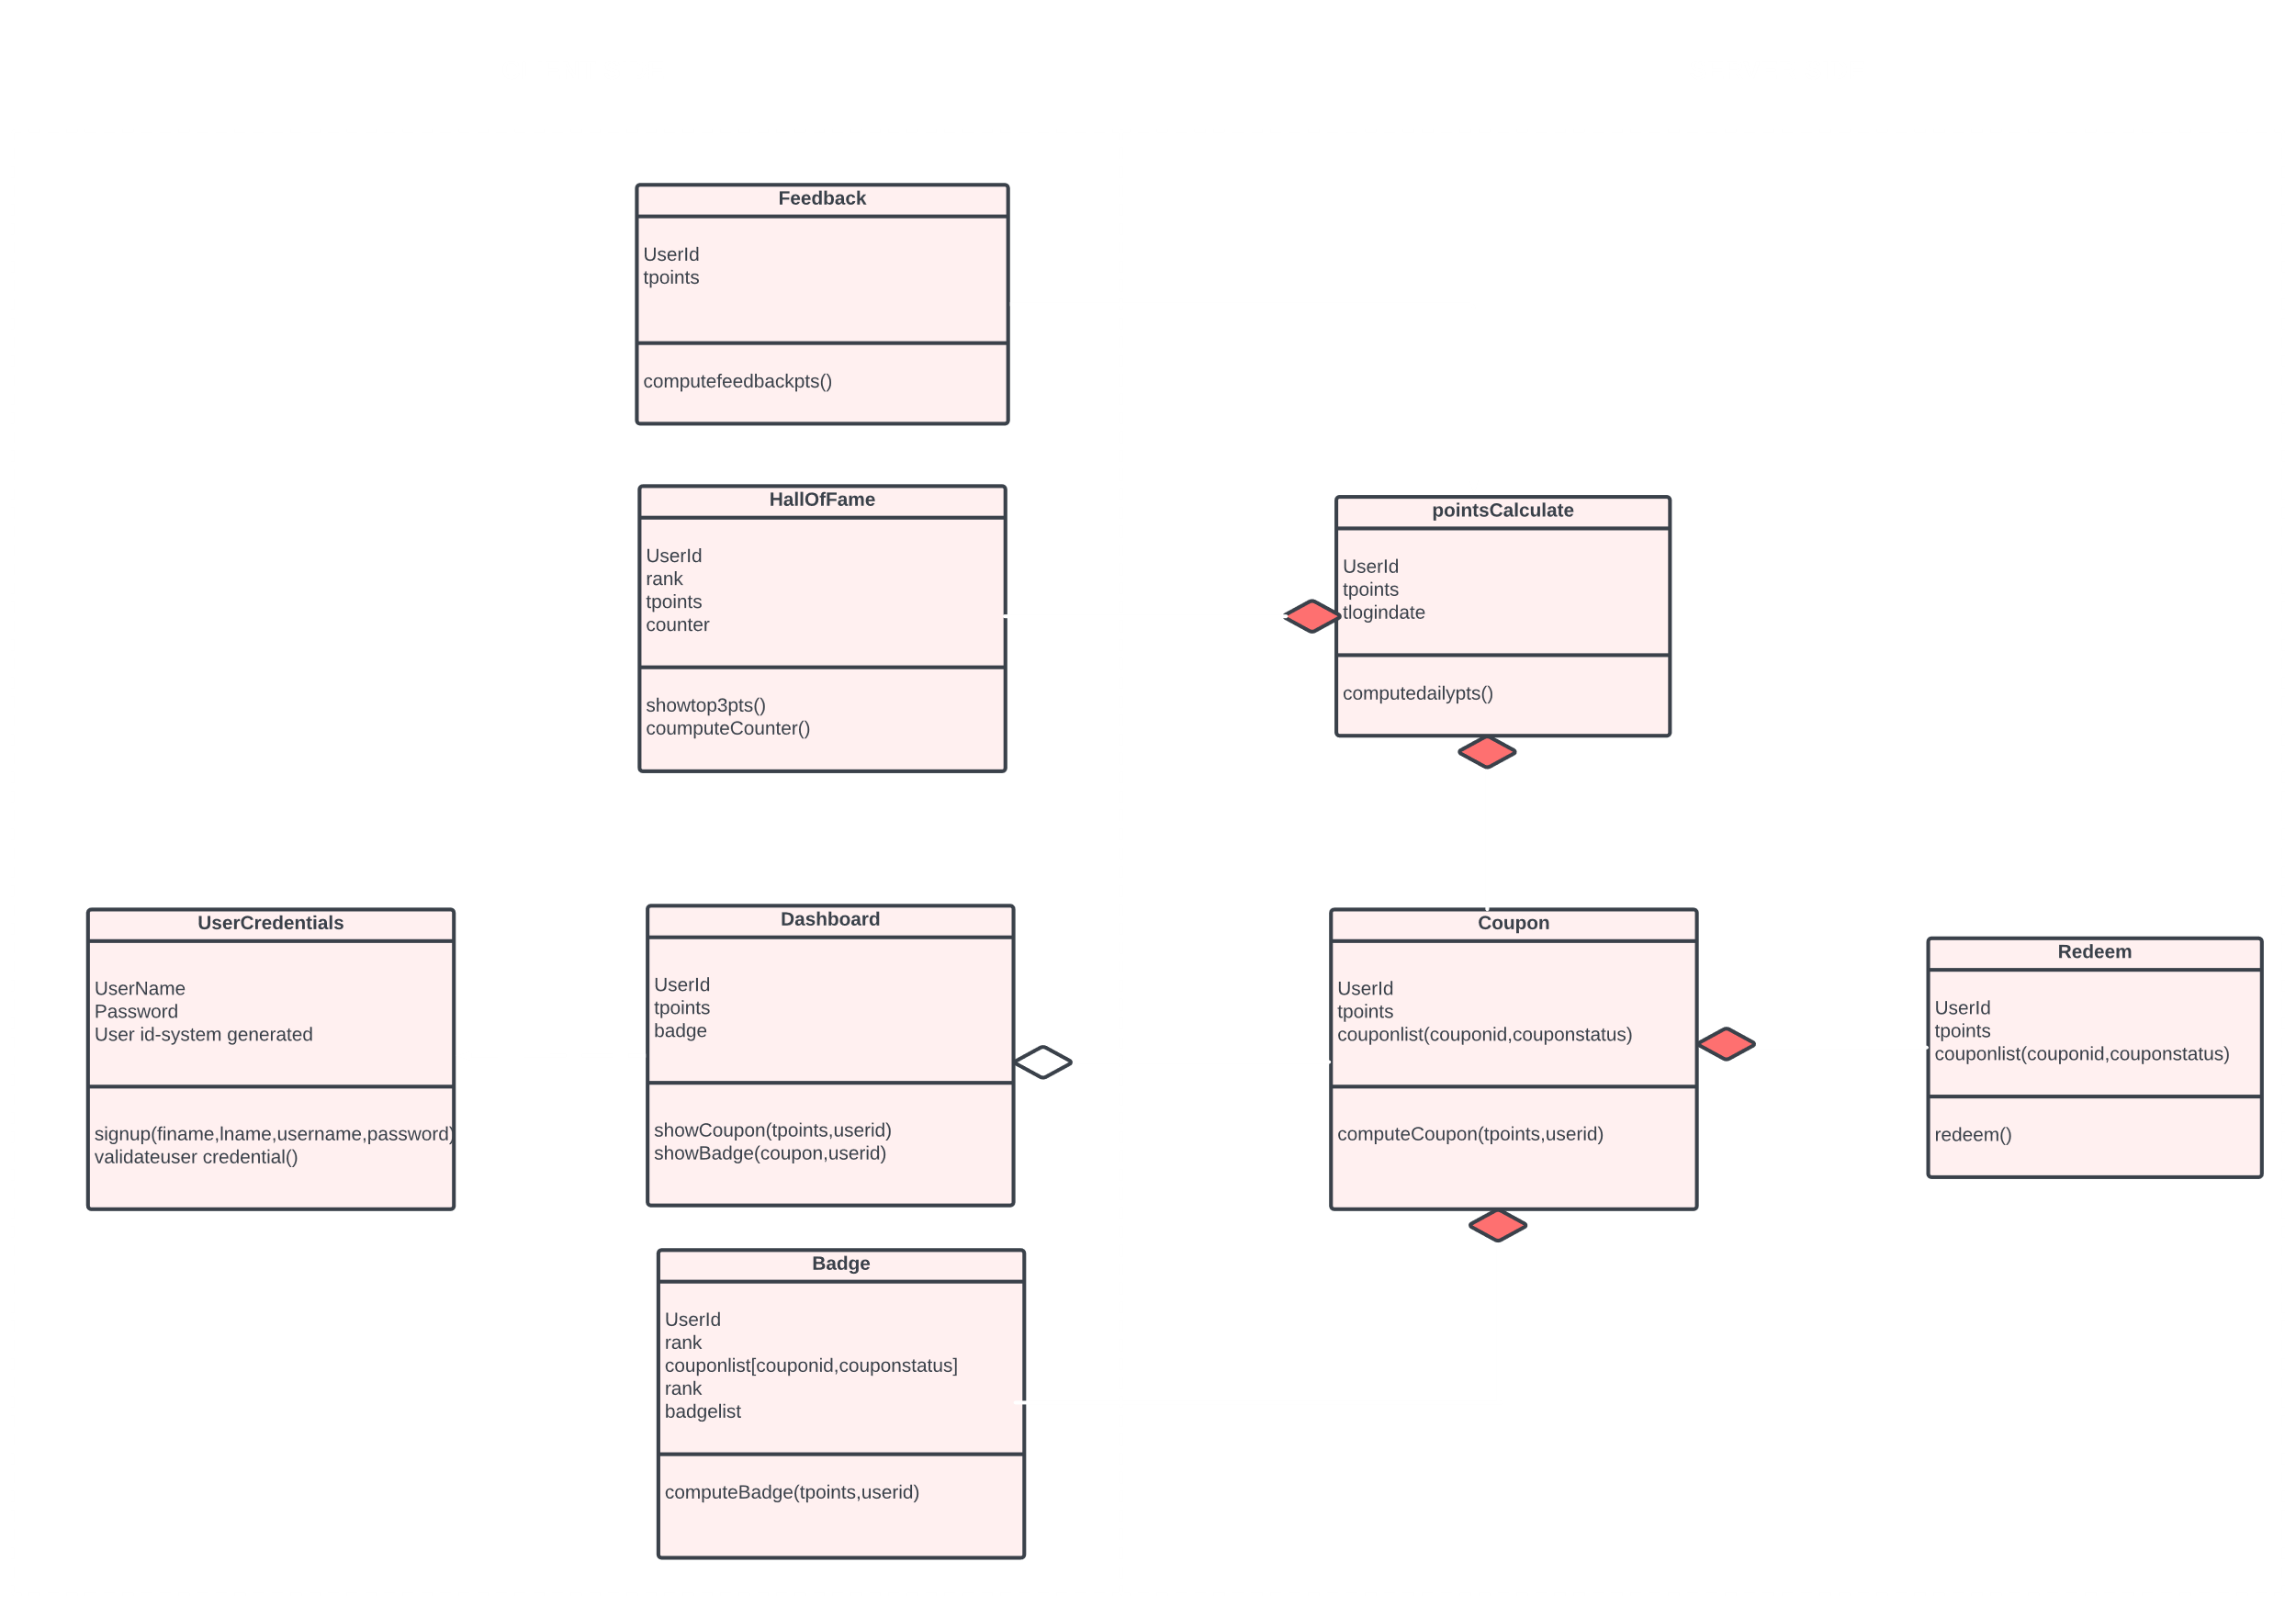
</System Model - Class Diagram
Notes:
We have defined the main classes and the function & attribute in individual classes
System Model depicted using class diagram
It has demarcation of the classes that will server for frontend and backend
Starting from Login / signup class – credentials validated- User id is primary key across all classes
Dashboard class – total points and badges that will be displayed at frontend – This details will be obtained from coupon,badges & points calculate class – total points is common variable that will be passed across the class that will undergo various manipulation
Hall of fame will be using the points class to display top performers
Coupons – will have coupon at user id level and their status (whether active, expired),
Feedback – points assigned will be captured and added to total points at user id level
Redeem – the total points will be decreased depending on coupons redeemed hence again tpoints coming in picture

Slide 7

</Thank You

